Slide 1
Simplified Reference Tissue Model 2 (SRTM2)
Sep 15, 2023
Zeyu Zhou
MIRA Group Meeting Review

Slide 2
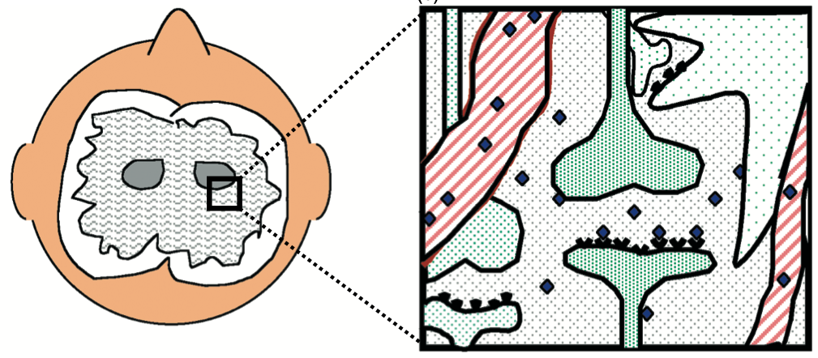
Receptor-ligand binding

Slide 3

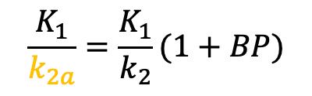


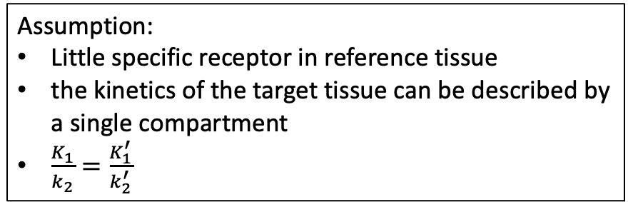
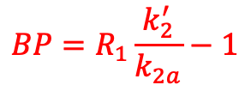


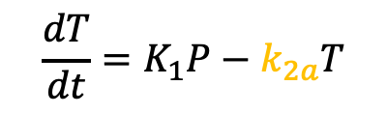


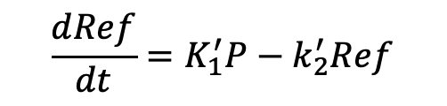


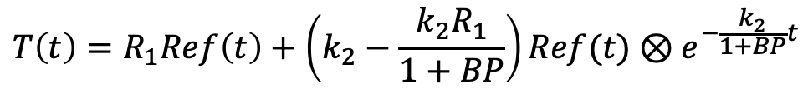
SRTM
Assumption:
Little specific receptor in reference tissue
the kinetics of the target tissue can be described by a single compartment
$\frac{K_{1}}{k_{2}}=\frac{K_{1}^{′}}{k_{2}^{′}}$
Target Tissue
$$K_{1}$$
$$T$$
$$\frac{dT}{dt}=K_{1}P−k_{2a}T$$
$$\frac{K_{1}}{k_{2a}}=\frac{K_{1}}{k_{2}}(1+BP)$$
$$k_{2a}$$
$$\frac{dRef}{dt}=K_{1}^{′}P−k_{2}^{′}Ref$$
$$P$$
Solution:
$$T\left(t\right)=R_{1}Ref\left(t\right)+\left(k_{2}−\frac{k_{2}R_{1}}{1+BP}\right)Ref(t)⊗e^{−\frac{k_{2}}{1+BP}t}$$
Parameters: ($R_{1}=\frac{K_{1}}{K_{1}^{′}}, k_{2},BP$)
$$K_{1}^{′}$$
$$Ref$$
$$k_{2}^{′}$$
Alternatively:
$$T\left(t\right)=R_{1}Ref\left(t\right)+R_{1}\left(k_{2}^{′}−k_{2a}\right)Ref(t)⊗e^{−k_{2a}t}$$
Parameters: ($R_{1},k_{2}^{′},k_{2a}$)
$$BP=R_{1}\frac{k_{2}^{′}}{k_{2a}}−1$$
Reference Tissue

Slide 4
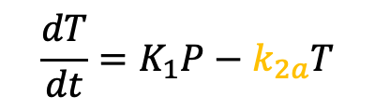
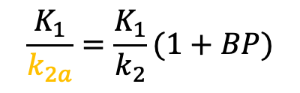
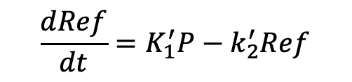
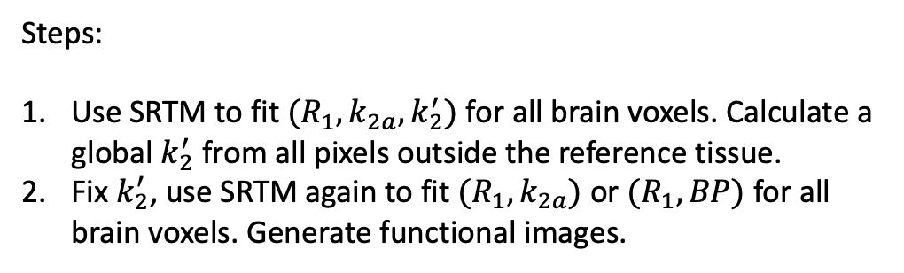
SRTM2
$$\frac{dT}{dt}=K_{1}P−k_{2a}T$$
$$\frac{K_{1}}{k_{2a}}=\frac{K_{1}}{k_{2}}(1+BP)$$
Target Tissue
$$\frac{dRef}{dt}=K_{1}^{′}P−k_{2}^{′}Ref$$
$$K_{1}$$
$$T$$
$$T\left(t\right)=R_{1}Ref\left(t\right)+R_{1}\left(k_{2}^{′}−k_{2a}\right)Ref(t)⊗e^{−k_{2a}t}$$
$$k_{2a}$$
Idea: one reference tissue one single value for $k_{2}^{′}$
$$P$$
Steps:
Use SRTM to fit $(R_{1}, k_{2a}, k_{2}^{′})$ for all brain voxels. Calculate a global $k_{2}^{′}$ from all pixels outside the reference tissue.
Fix $k_{2}^{′}$, use SRTM again to fit $(R_{1},k_{2a})$ or $(R_{1},BP)$ for all brain voxels. Generate functional images.
$$K_{1}^{′}$$
$$Ref$$
$$k_{2}^{′}$$
Advantage: better noise reduction compared to SRTM
Reference Tissue

